Slide 1
Chapter-1

Slide 2
What is software engineering?
Definitions:
“A systematic collection of good program development practices and techniques”.
“An engineering approach to develop software”.
Software engineering discusses systematic and cost-effective techniques for software
development. These techniques help develop software using an engineering
approach.

Slide 3
Is software engineering a science or an art?
Learning from Experience
Software engineering, like other engineering fields, depends on practical knowledge gained from past experiences. These experiences are carefully organized and, wherever possible, supported by theoretical explanations. When theories are unavailable, practical rules from real-world experience are used.
Science, on the other hand, relies on rigorous, provable principles and systematic experimentation.
Balancing Conflicting Goals
Engineering problems, including those in software engineering, often involve conflicting goals. For instance, while designing a solution, you might need to balance cost, maintainability, and usability.
Engineers typically propose multiple solutions.
Then, the best solution is chosen after considering various trade-offs.
This process often involves iterations and refinements, reflecting a pragmatic approach to problem-solving
Use of Well-Documented Principles
Engineering disciplines, including software engineering, rely on well-understood and clearly documented principles. This systematic approach ensures consistency and reliability.
In contrast, art relies more on subjective judgment, intuition, and creativity, often using less-defined or vague principles.

Slide 4
EVOLUTION—FROM AN ART FORM TO A N ENGINEERING DISCIPLINE :
Evolution of an Art into an Engineering Discipline:
The early programmers used an ad hoc programming style. This style of program development is now variously being referred to as exploratory, build and fix, and code and fix styles.
Evolution Pattern for Engineering Disciplines:

Slide 5
A Solution to the Software Crisis:
Not only are the software products becoming progressively more expensive than hardware, but they also present a host of other problems to the customers—software products are difficult to alter, debug, and enhance; use resources non-optimally; often fail to meet the user requirements; are far from being reliable; frequently crash; and are often delivered late.

Slide 6
SOFTWARE DEVELOPMENT PROJECTS
Programs versus Products:
Types of Software Development Project:
  Software products:
i)We all know of a variety of software such as Microsoft’s Windows and the Office suite, Oracle DBMS, software accompanying a camcorder or a laser printer, etc. These software are available off-the-shelf for purchase and are used by a diverse range of customers. These are called generic software products
ii) Many companies find it advantageous to develop product lines that target slightly different
market segments based on variations of essentially the same software.
  Software services:
i) A customised software is developed according to the specification drawn up by one or at most a few customers.
ii) Another type of software service is outsourced software. Sometimes, it canmake good commercial sense for a company developing a large project to outsource some parts of its development work to other companies.
Software Projects Being Undertaken by Indian Companies:

Slide 7
EXPLORATORY STYLE OF SOFTWARE DEVELOPMENT:
What is wrong with the exploratory style of software development?

Slide 8
The psychological or perceived complexity of a problem concerns the difficulty level experienced by a programmer while solving the problem using the exploratory development style.
The answer is that it is very difficult to apply the decomposition and abstraction principles to completely overcome the problem complexity.

Slide 9
Perceived Problem Complexity: An Interpretation Based on:
Human Cognition Mechanism:
Psychologists say that the human memory can be thought to consist of two distinct parts[Miller 56]: short-term and long-term memories.
Short-term memory:
The short-term memory is also sometimes referred to as the working memory.
The short-term memory of an average person can store up to seven items; but in extreme cases it can
vary anywhere from five to nine items ( 7 ± 2).

Slide 10
As you can notice, this model is very similar to the organisation of a computer in terms of cache, main memory, and processor.
Long-term memory:
Unlike the short-term memory, the size of the long-term memory is not known to have a definite upper bound.
Consider contact number 9433795369.
This phenomenon of forming one item from several items is referred to as chunking by psychologists.
For example, if you are given the binary number 110010101001
Evidence of short-term memory:
The magical number 7: Miller called the number seven as the magical number [Miller 56] since if a person deals with seven or less number of unrelated information at a time these would be easily accommodated in the short-term memory.

Slide 11
Principles Deployed by Software Engineering to Overcome:
Human Cognitive Limitations:
Two important principles that are deployed by software engineering to overcome the
problems arising due to human cognitive limitations are—abstraction and
decomposition.

Slide 12
Abstraction:
Abstraction refers to construction of a simpler version of a problem by ignoring the details. The principle of constructing an abstraction is popularly known as modelling (or model construction ).
Decomposition:
The decomposition principle advocates decomposing the problem into many small independent parts. The small parts are then taken up one by one and solved separately. The idea is that each small part would be easy to grasp and understand and can be easily solved. The full problem is solved when all the parts are solved.

Slide 13
EMERGENCE OF SOFTWARE ENGINEERING:
This evolution is the result of a series of innovations and accumulation of experience about writing good quality programs.
Early Computer Programming:
Every programmer developed his own individualistic style of writing programs according to his intuition and
used this style ad hoc while writing different programs.
High-level Language Programming:
Computers became faster with the introduction of the semiconductor technology in the early 1960s. Faster semiconductor transistors replaced the prevalent vacuum tube-based circuits in a computer. With the availability of more powerful computers, it became possible to solve larger and more complex problems. At this time, high-level languages such as FORTRAN, ALGOL, and COBOL were introduced.
Control Flow-based Design:
To cope up with exploratory software development problem, experienced programmers advised other programmers to pay particular attention to the design of a program’s control flow structure.
A program’s control flow structure indicates the sequence in which the program’s instructions are executed.

Slide 15
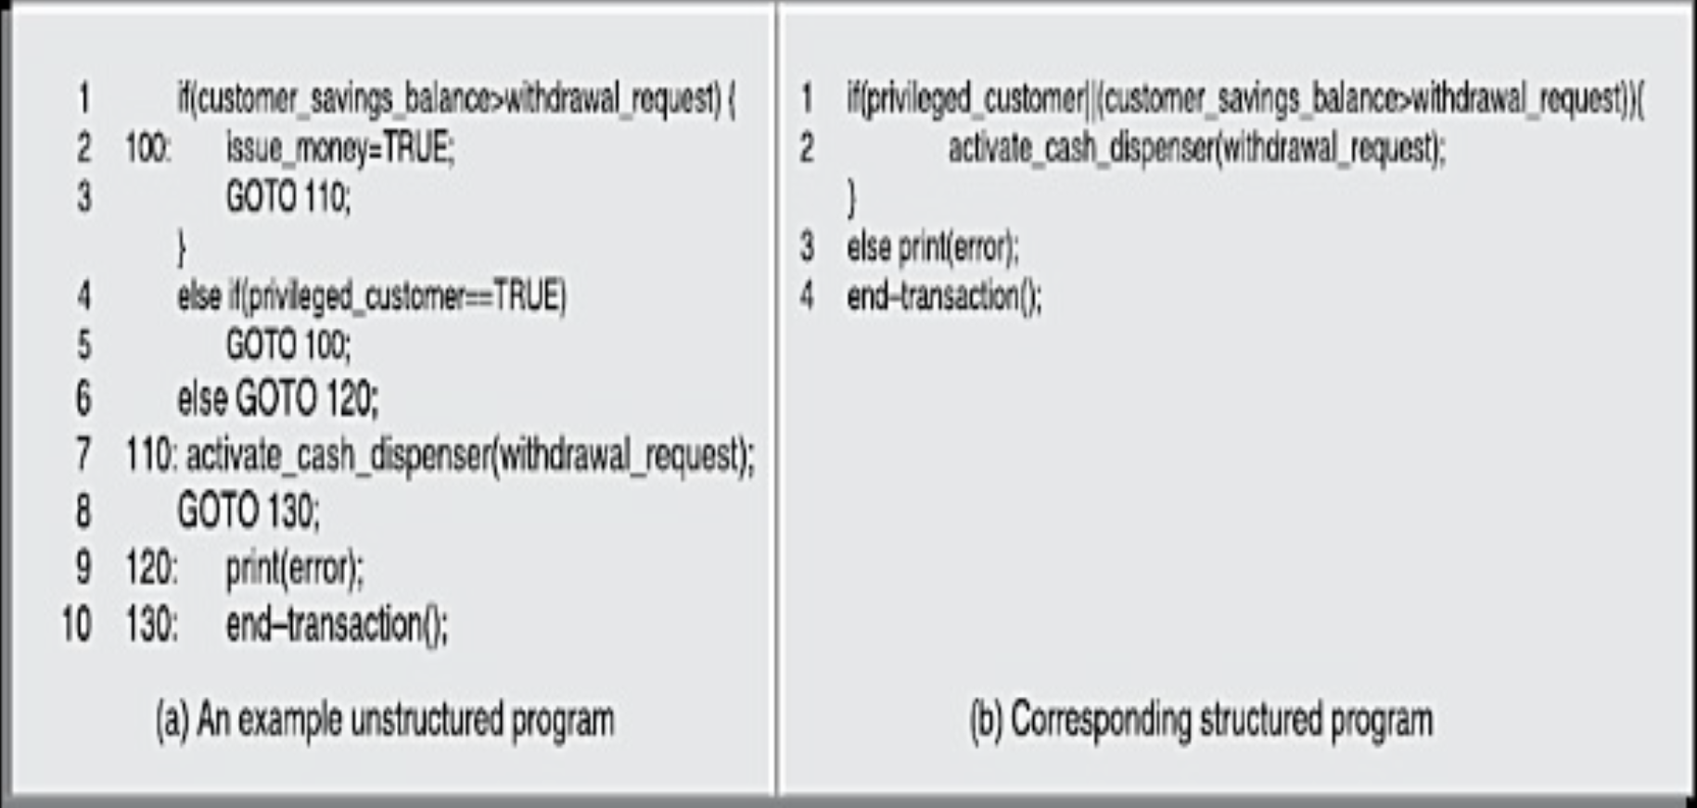
Control flow graphs of the programs of Figures unstructured and structured

Slide 16
CFG of a program having too many GO TO statements.

Slide 17
Structured programming—a logical extension:
It was conclusively proved by Bohm and Jacopini that only three programming constructs—sequence, selection, and
iteration—were sufficient to express any programming logic.
A program is called structured when it uses only the sequence, selection, and iteration
types of constructs and is modular.
Data Structure-oriented Design:
Computers became even more powerful with the advent o f integrated circuits (ICs) in the early seventies. These could now be used to solve more complex problems.
Using data structure-oriented design techniques, first a program’s data structures are designed.
The code structure is designed based on the data structure.
An example of a data structure-oriented design technique is the Jackson’s Structured Programming (JSP) technique developed by Michael Jackson.
Data Flow-oriented Design:
The data flow-oriented techniques advocate that the major data items handled by a
system must be identified and the processing required on these data items to
produce the desired outputs should be determined.

Slide 18
The functions (also called as processes ) and the data items that are exchanged between the different functions are represented in a diagram known as a data flow diagram (DFD).
DFDs: A crucial program representation for procedural program design:
Object-oriented Design:
Each object essentially acts as a data hiding (also known as data abstraction ) entity.

Slide 19
What Next?

Slide 20
Draw the CFG for the below code.
main(){
int y=1;
if(y<0)
if(y>0) y=3;
else y=0;
printf(“%d\n”,y);
}

Slide 21
NOTABLE CHANGES IN SOFTWARE DEVELOPMENT PRACTICES:
An important difference is that the exploratory software development style is based on error correction (build and fix) while the software engineering techniques are based on the principles of error prevention.
In the exploratory style, coding was considered synonymous with software development. For instance, this naive w a y of developing a software believed in developing a working system as quickly as possible and then successively modifying it until it perform satisfactorily.
A lot of attention is now being paid to requirements specification.
Now there is a distinct design phase where standard design techniques are employed to yield coherent and complete design models.
By visibility we mean production of good quality, consistent and peer reviewed documents at
the end of every software development activity

Slide 22
COMPUTER SYSTEMS ENGINEERING:

Slide 23
SOFTWARE LIFE CYCLE MODELS:
Activities are graphically modelled (represented) as well as textually described and are variously called a s software life cycle model, software development life cycle (SDLC) model, and software development process model.
The genesis of the agile model can be traced to the radical changes to the types of
project that are being undertaken at present, rather than to any radical innovations to
the life cycle models themselves. The projects have changed from large multi-year
product development projects to small services projects now.
A FEW BASIC CONCEPTS
Software life cycle
The life cycle of a software represents the series of identifiable stages through which
it evolves during its life time.
Software development life cycle (SDLC) model:
An SDLC graphically depicts the different phases through which a software evolves. It
is usually accompanied by a textual description of the different activities that need to
be carried out during each phase.
Process versus methodology:
A software development process has a much broader scope as compared to a
software development methodology. A process usually describes all the activities
starting from the inception of a software to its maintenance and retirement stages, or
at least a chunk of activities in the life cycle. It also recommends specific
methodologies for carrying out each activity. A methodology, in contrast, describes
the steps to carry out only a single or at best a few individual activities

Slide 24
Why use a development process?
Software development organisations have realised that adherence to a suitable life cycle model helps to produce good quality software and that helps minimise the chances of time and cost overruns.
Why document a development process?
A documented development process forms a common understanding of the activities to be carried out among the software developers and helps them to develop software in a systematic and disciplined manner. A documented development process model, besides preventing the misinterpretations that might occur when the development
process is not adequately documented, also helps to identify inconsistencies, redundancies, and omissions in the development process.
Phase entry and exit criteria:
The phase entry (or exit) criteria is usually expressed as a set of conditions that needs to be be satisfied for the phase to start (or to complete). As an example, the phase exit criteria for the software requirements specification phase, can be that the software requirements specification (SRS) document is ready, has been reviewed internally, and
also has been reviewed and approved by the customer.

Slide 25
WATERFALL MODEL AND ITS EXTENSIONS:
We can think of the waterfall model as a generic model that has been extended in many ways for catering to certain specific software development situations to realise all other software life cycle models.
1 Classical Waterfall Model:
Classical waterfall model is intuitively the most obvious way to develop software. It is simple but idealistic.

Slide 26
Phases of the classical waterfall model:
An activity that spans all phases of software development is project management.
Feasibility study:
The main focus of the feasibility study stage is to determine whether it would be financially and technically feasible to develop the software.
Development of an overall understanding of the problem: Screen layouts required in the graphical user interface (GUI).
Formulation of the various possible strategies for solving the problem:In this activity, various possible high-level solution schemes to then problem are determined.(client-server/stand-alone).
Evaluation of the different solution strategies:estimates of the resources required, cost of development, and development time required

Slide 27
Requirements analysis and specification:
Requirements gathering and analysis:
  collect all relevant information
  gathered requirements are analysed.(inconsistent and incomplete).
Requirements specification: After the requirement gathering andanalysis activities are complete, the identified requirements are documented. This is called a software requirements specification (SRS) document.
Design:
Procedural design approach:This traditional design technique is based on the data flow-oriented design
approach. It consists of two important activities; first structured analysis of the requirements specification is carried out where the detailed structure of the problem is examined. This is followed by a structured design step where the results of structured analysis are transformed into the software design.
Structured design consists of two main activities—architectural design (also called high-level design ) and detailed design (also called Low-level design ).
Object-oriented design approach:
In this technique, various objects that occur in the problem domain and the solution domain are first identified and the different relationships that exist among these objects are identified. The object structure is further refined to obtain the detailed design.
Coding and unit testing:
implementation phase
unit testing include designing test cases, testing, debugging to fix problems, and
management of test cases.

Slide 28
Integration and system testing:
Integration testing is carried out to verify that the interfaces among different units are working satisfactorily. On the other hand, the goal of system testing is to ensure that the developed system conforms to the requirements that have been laid out in the SRS document.
System testing usually consists of three different kinds of testing activities:
  Alpha-testing: testing is the system testing performed by the development team.
  Beta-testing: This is the system testing performed by a friendly set of customers.
  Acceptance testing: After the software has been delivered, the customer performs system testing to determine whether t o accept the delivered software or to reject it.
Maintenance:
Corrective maintenance:
Perfective maintenance:
Adaptive maintenance:
Shortcomings of the classical waterfall model
No feedback paths: requires that all activities during a phase are flawlessly carried out.
Difficult to accommodate change requests:creating an unambiguous and complete set of requirements.
Inefficient error corrections:harder to resolve.
No overlapping of phases:large number of team members to idle for extended periods
Is the classical waterfall model useful at all?
Irrespective of the life cycle model that is actually followed for a product development, the final documents are always written to reflect a classical waterfall model of development, so that comprehension of the documents becomes easier for any one reading the document.

Slide 29
Iterative Waterfall Model:
The main change brought about by the iterative waterfall model to the classical waterfall model is in the form of providing feedback paths from every phase to its preceding phases.
Phase containment of errors:
It is advantageous to detect these errors in the same phase in which they take place, since early detection of bugs reduces the effort and time required for correcting those.
The principle of detecting errors as close to their points of commitment as possible is
known as phase containment of errors.

Slide 30
Phase overlap:
In spite of the best effort to detect errors in the same phase in whichmthey are committed, some errors escape detection and are detected in a later phase.
If strict phase transitions are maintained, then the team members who complete their work early would idle waiting for the phase to be complete, and are said to be in a blocking state.
              Distribution of effort for various phases in the iterative waterfall model

Slide 31
Shortcomings of the iterative waterfall model:
Difficult to accommodate change requests: Once requirements have been frozen, the waterfall model provides no scope for any modifications to the requirements.
Incremental delivery not supported:poor fit to the customer’s requirements.
Phase overlap not supported: a rigid phase sequence
Error correction unduly expensive:validation incur expensive rework and result in cost escalation and delayed delivery
Limited customer interactions:validation incur expensive rework and result in cost escalation and delayed delivery
Heavy weight: overemphasises documentation
No support for risk handling and code reuse:significant reuse of existing development artifacts.

Slide 32
V-Model:
In each development phase, along with the development of a work product, test case design and the plan for testing the work product are carried out, whereas the actual testing is carried out in the validation phase.
In the validation phase, testing is carried out in three steps—unit, integration, and system testing.

Slide 33
V-model versus waterfall model:
In this model, development and validation activities proceed hand in hand.
Advantages of V-model:”
In the V-model, much o f the testing activities (test case design, test planning, etc.) are carried out in parallel with the development activities.
The quality of the test cases are usually better.
more efficient manpower utilisation.
build up a good understanding of the development artifacts, and this in turn, helps them to carry out effective testing of the software.
Disadvantages of V-model:
Being a derivative of the classical waterfall model, this model inherits most of the weaknesses of the waterfall model.

Slide 34
Prototyping Model:
This model suggests building a working prototype of the system, before development of the actual software. A prototype is a toy and crude implementation of a system. It has limited functional capabilities, low reliability, or inefficient performance as compared to the actual software.
The shortcuts usually involve developing inefficient, inaccurate, or dummy functions. The shortcut implementation of a function, for example, may produce the desired results by using a table look-up rather than by performing the actual computations. Normally the term rapid prototyping is used when software tools are used for prototype construction. For example, tools based on fourth generation languages (4GL) may be used to construct the prototype for the GUI parts.
Necessity of the prototyping model:
The GUI part of a software system is almost always developed using the prototyping
model
Lack of familiarity with a required development technology is a technical risk. Often, major design decisions depend on issues such as the response time of a hardware controller, or the efficiency of a sorting algorithm.
An important reason for developing a prototype is that it is impossible to “get it right” the first time.
The prototyping model is considered to be useful for the development of not only the
GUI parts of a software, but also for a software project for which certain technical
issues are not clear to the development team

Slide 35
Life cycle activities of prototyping model:
Software is developed through two major activities—prototype construction and iterative waterfall-based
software development.
Prototype development:
Prototype development starts with an initial requirements gathering phase. A quick design is carried out and a prototype is built. The developed prototype is submitted to the customer for evaluation. Based on the customer feedback, the requirements are refined and the prototype is suitably modified.
Iterative development:
Once the customer approves the prototype, the actual software is developed using the iterative waterfall approach.
Even though the construction of a throwaway prototype might involve incurring additional cost, for systems with unclear customer requirements and for systems with unresolved technical issues, the overall development cost usually turns out to be lower compared to an equivalent system developed using the iterative waterfall model.

Slide 36
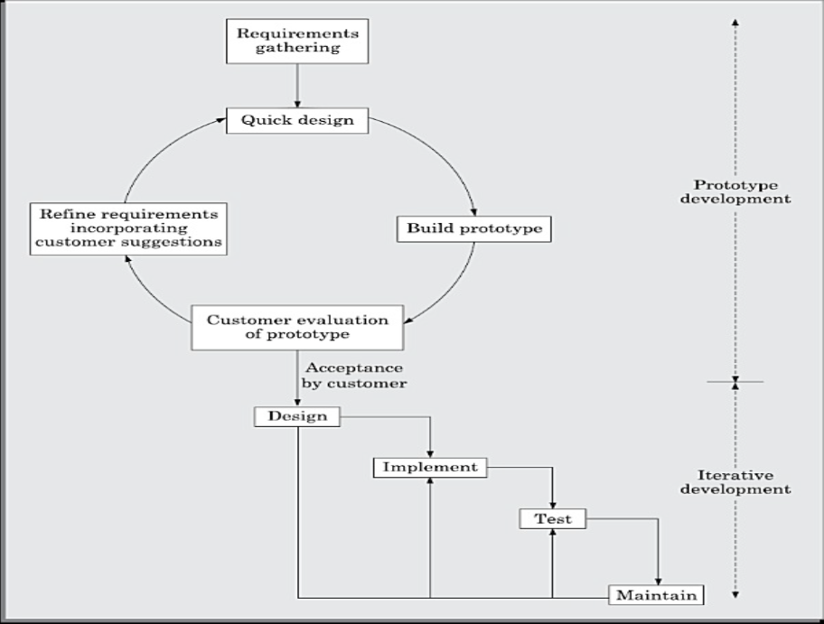

Slide 37
Strengths of the prototyping model:
This model is the most appropriate for projects that suffer from technical and requirements risks. A constructed prototype helps overcome these risks.
Weaknesses of the prototyping model:
The prototype model can increase the cost of development for projects that are routine development work and do not suffer from any significant risks.
Since the prototype is constructed only at the start of the project, the prototyping model is ineffective for risks identified later during the development cycle.

Slide 38
Incremental Development Model:
This life cycle model is sometimes referred to as the successive versions model and sometimes as the incremental model.
Life cycle activities of incremental development model:
In the incremental life cycle model, the requirements of the software are first broken down into several modules or features that can be incrementally constructed and delivered.

Slide 40
Advantages:
Error reduction:
Incremental resource deployment:

Slide 41
Evolutionary Model:
In the incremental development model, complete requirements are first developed and the SRS document
prepared. In contrast, in the evolutionary model, the requirements, plan, estimates, and solution evolve over the
iterations, rather than fully defined and frozen in a major up-front specification effort before
the development iterations begin.
Advantages:
Effective elicitation of actual customer requirements:
Easy handling change requests:

Slide 42
Disadvantages:
Feature division into incremental parts can be non-trivial:
For many development projects, especially for small-sized projects, it is difficult to divide the required features into several parts that can be incrementally implemented and delivered.
Adhoc design:Since at a time design for only the current increment is done, the design can become ad hoc without specific attention being paid to maintainability and optimality.
Applicability of the evolutionary model:
The evolutionary model is normally useful for very large products, where it is easier to find modules for incremental implementation. Often evolutionary model is used when the customer prefers to receive the product in increments.
The evolutionary model is well-suited to use in object-oriented software development
projects

Slide 43
RAPID APPLICATION DEVELOPMENT (RAD):
The rapid application development (RAD) model was proposed in the early nineties in an attempt to overcome the rigidity of the waterfall model (and its derivatives) that makes it difficult to accommodate any change
requests from the customer.
The major goals of the RAD model are as follows:
To decrease the time taken and the cost incurred to develop software systems.
To limit the costs of accommodating change requests.
To reduce the communication gap between the customer and the developers.
Main motivation:
In the iterative waterfall model, the customer requirements need to be gathered, analysed, documented, and signed off upfront, before an development could start.
Working of RAD:
In the RAD model, development takes place in a series of short cycles or iterations. At any time, the development team focuses on the present iteration only, and therefore plans are made for one increment at a time. The time planned for each iteration is called a time box.
How does RAD facilitate accommodation of change requests?
Two main ways—minimal use of planning and heavy reuse of any existing code through rapid prototyping.
Visual style of development.
Use of reusable components

Slide 44
Applicability of RAD Model
Customised software:
Non-critical software
Highly constrained project schedule:
Large software:
Application characteristics that render RAD unsuitable
Generic products (wide distribution):
Requirement of optimal performance and/or reliability:
Lack of similar products:
Monolithic entity:

Slide 45
Comparison of RAD with Other Models:
RAD versus prototyping model:
Though RAD is expected to lead to faster software development compared to the traditional models (such as the prototyping model), though the quality and reliability would be inferior.
RAD versus iterative waterfall model:
In the iterative waterfall model, all the functionalities of a software are developed together. On the other hand, in the RAD model the product functionalities are developed incrementally through heavy code and
design reuse.
RAD versus evolutionary model:
Incremental development is the hallmark of both evolutionary and RAD models. However, in RAD each increment results in essentially a quick and dirty prototype, whereas in the evolutionary model each increment
is systematically developed using the iterative waterfall model.

Slide 46
AGILE DEVELOPMENT MODELS:
Over the last two decades or so, projects using iterative waterfall-based life cycle models are becoming rare due to the rapid shift in the characteristics of the software development projects over time. Two changes that are becoming noticeable are rapid shift from development of software products to development of customized software
and the increased emphasis and scope for reuse.
Why the waterfall-based development was becoming difficult to use in project in recent times:
Changes to the requirements after the SRS document has been completed are discouraged.
The sales revenue generated world wide from services already exceeds that of the software products. Clearly, iterative waterfall model is not suitable for development of such software.
Waterfall model is called a heavy weight model, since there is too much emphasis on producing documentation and usage of tools.
Waterfall model prescribes almost no customer interactions after the requirements have been specified.
The agile software development model was proposed in the mid-1990s to overcome the serious shortcomings of the waterfall model of development identified above:
Crystal
Atern (formerly DSDM)
Feature-driven development
Scrum
Extreme programming (XP)
Lean development
Unified process

Slide 47
At a time, only one increment is planned, developed, and then deployed at the customer site. No long-term plans are made. The
time to complete an iteration is called a time box. The implication of the term time box is that the end date for an iteration does not change.
Essential Idea behind Agile Models:
At the end of each iteration, stakeholders and the customer representative review the progress made and re-evaluate the requirements. A distinguishing characteristics of the agile models is frequent delivery of software increments to the customer.
The agile model emphasises incremental release of working software as the primary
measure of progress.
The following important principles behind the agile model were publicized in the agile manifesto in 2001:
Working software over comprehensive documentation.
Frequent delivery of incremental versions of the software to the customer in intervals of few weeks.
Requirement change requests from the customer are encouraged and are efficiently incorporated.
Having competent team members and enhancing interactions among them is considered much more important than issues such as usage of sophisticated tools or strict adherence to a documented process. It is advocated that enhanced communication among the development team members can be realised through face-to-face communication rather than through exchange of formal documents.
Continuous interaction with the customer is considered much more important rather than effective contract negotiation. A customer representatives is required to be a part of the development team, thus facilitating close, daily co-operation between customers and developers.

Slide 48
Advantages and disadvantages of agile methods:
Lack of formal documents
Difficult to get important project decisions such as design decisions to be reviewed by external experts.
maintenance
can become a problem.
Agile model versus iterative waterfall model:
Agile versus exploratory programming:
Agile model versus RAD model:

Slide 49
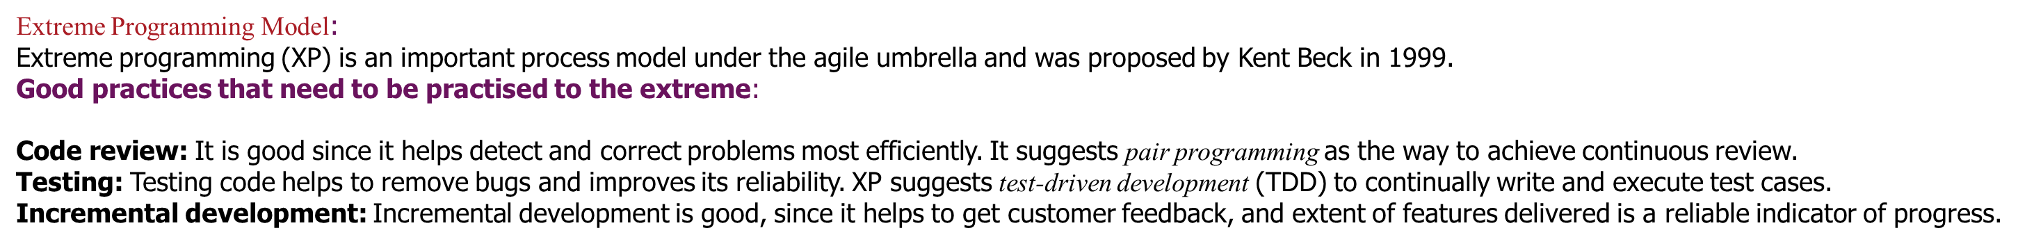
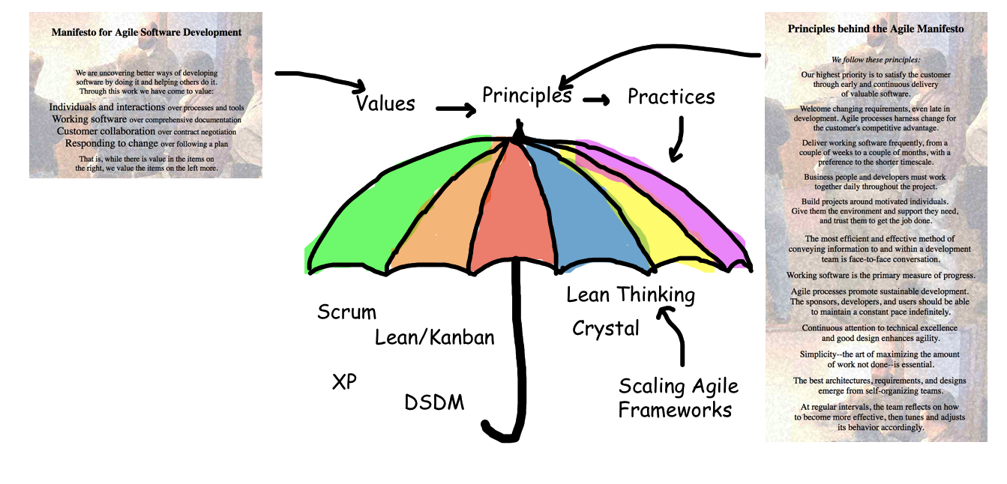

Slide 50
Simplicity: Simplicity makes it easier to develop good quality code, as well as to test and debug it.
creating the simplest code, one can ignore the aspects such as efficiency, reliability, maintainability, etc. Once the simplest thing works, other aspects can be introduced through refactoring.
Design:Since having a good quality design is important to develop a good quality solution, everybody should design daily. This can be achieved through refactoring, whereby a working code is improved for efficiency and maintainability.
Integration testing: It is important since it helps identify the bugs at the interfaces of different functionalities
Basic idea of extreme programming model:
A user story is a simplistic statement of a customer about a functionality he needs, it does not mention about finer details such as the different scenarios that can occur, the precondition (state at which the system) to be satisfied before the feature can be invoked, etc.
The development team may decide to construct a spike for some feature. A spike, is a very simple program
that is constructed to explore the suitability of a solution being proposed. A spike can be considered to be similar to a prototype.
Coding:
Testing: XP places high importance on testing and considers it be the primary means for developing a fault-free
software.
Listening: The developers need to carefully listen to the customers if they have to develop a good quality software.
Designing:
Feedback:
Simplicity: A corner-stone of XP is based on the principle: “build something simple that will work today, rather than trying to build something that would take time and yet may never be used”.

Slide 51
XP is in favour of making the solution to a problem as simple as possible. In contrast, the traditional system development methods recommend planning for reusability and future extensibility of code and design at the expense of higher code and design complexity.
Applicability of extreme programming model:
Projects involving new technology or research projects:
Small projects:
Project characteristics not suited to development using agile models:
Stable requirements:
Mission critical or safety critical systems:

Slide 52
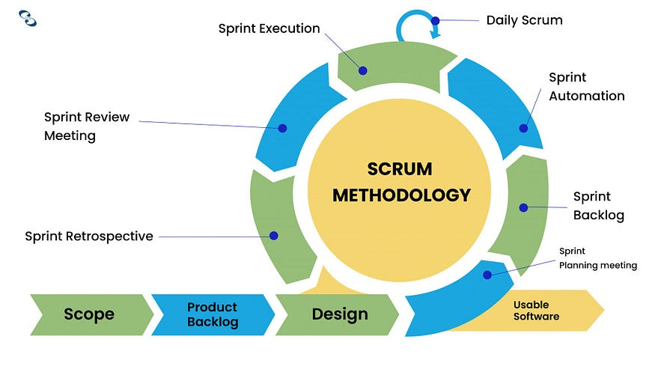
What is Scrum?
Scrum is an Agile framework designed for software development projects. It is a collaborative, iterative, and incremental approach that promotes teamwork, flexibility, and the continuous delivery of high-quality software. Scrum is well-suited for complex projects requiring adaptive solutions.

Slide 53
Three fundamental roles— software owner, scrum master, and team member.
The software owner is responsible for communicating the customers vision of the software to the development team.
The scrum master acts as a liaison between the software owner and the team, thereby facilitating the development work.
A scrum team usually consists of cross-functional team members.
Scrum Artifacts:
Product Backlog:
  A prioritized list of all features, tasks, and improvements that need to be developed.
  Acts as a dynamic document updated throughout the project lifecycle.
Sprint Backlog:
  A subset of the product backlog selected for a specific sprint.
  Includes tasks to achieve the sprint goal.
Sprint Burndown Chart:
  A graphical representation showing the progress of work completed versus the work remaining in the sprint.
  Tracks daily progress and ensures on-time delivery.

Slide 54
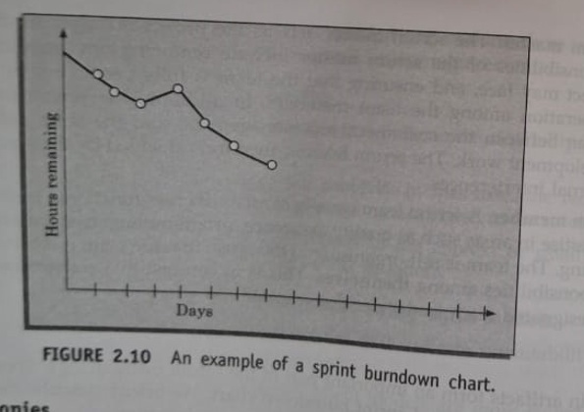
Scrum Ceremonies
Sprint Planning:
  The team defines the sprint goal and selects tasks from the product backlog for the sprint.
Daily Stand-up:
  A short, time-boxed meeting to discuss progress, roadblocks, and the next steps.
Sprint Review:
  Conducted at the end of a sprint to showcase completed work to stakeholders.
Sprint Retrospective:
  A reflective session for the team to identify improvements for future sprints.

Slide 55
Lean Software Development
Originates from Toyota's production system aimed at reducing waste and optimizing processes.
Focuses on identifying and eliminating delays and bottlenecks in workflows.
Emphasizes reducing non-value-adding activities such as rework, scope creep, delays in staffing, and excessive documentation.
Kanban, a core Lean technique, visualizes workflows to minimize delays and improve efficiency.
Kanban Methodology
Definition: A Japanese word meaning "signboard," Kanban provides a visual representation of the workflow.
Objective: Helps manage work in progress (WIP) limits and reduce bottlenecks by tracking cycle time.
Usage in Software Development: Highly effective for identifying delays and improving flow visibility, similar to its success in manufacturing.
Kanban Board
Structure: Divided into columns representing different stages of development (e.g., design, code, test, integration).
Kanban Cards: Represent tasks or work items moved through stages until completion.
Purpose: Visualizes the process, highlights bottlenecks, and ensures WIP limits to maintain productivity.
Benefits of the Kanban Approach
Visibility: Improves workflow clarity for developers.
Focus on Bottlenecks: Identifies overloaded stages causing delays.
Productivity Gains: Reduces stress, optimizes task management, and enhances overall product quality.

Slide 56
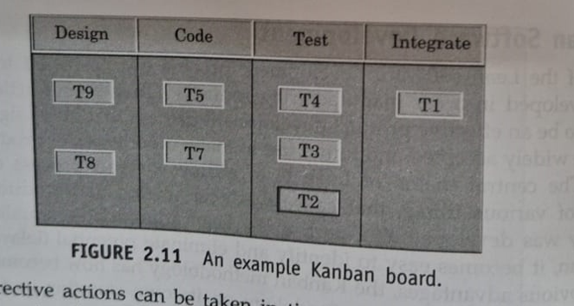

Slide 57
SPIRAL MODEL:

Slide 58
Risk handling in spiral model:This risk can be resolved by building a prototype of the data access subsystem and
experimenting with the exact access rate.
Phases of the Spiral Model:
Quadrant 1: The objectives are investigated, elaborated, and analysed.
Quadrant 2: During the second quadrant, the alternative solutions are evaluated to select the best possible solution.
Quadrant 3: Activities during the third quadrant consist of developing an verifying the next level of the software.
Quadrant 4: Activities during the fourth quadrant concern reviewing the results of the stages traversed so far (i.e. the developed version of the software) with the customer and planning the next iteration of the spiral.
The radius of the spiral at any point represents the cost incurred in the project so far, and the angular dimension represents the progress made so far in the current phase.
Advantages/pros and disadvantages/cons of the spiral model:
Spiral model as a meta model:
Waterfall model
Prototyping model
Evolutionary model

Slide 59
A COMPARISON OF DIFFERENT LIFE CYCLE MODELS:
The classical waterfall model cannot be used in practical development projects.
The iterative waterfall model is probably the most widely used software development model so far.
The prototyping model is suitable for projects for which either the user requirements or the underlying technical aspects are not well understood, however all the risks can be identified before the project starts.
The evolutionary approach is suitable for large problems which can be decomposed into a set of modules for incremental development and delivery. This model is also used widely for object-oriented development projects.
The spiral model is considered a meta model and encompasses all other life cycle models. Flexibility and risk handling are inherently built into this model.

Slide 60
Selecting an Appropriate Life Cycle Model for a Project:
Characteristics of the software to be developed:
Characteristics of the development team:
Characteristics of the customer:

